Slide 1
COREMAP DATA SCIENTIST CANDIDATE HOMEWORK PROBLEM
Scott Stearns
13 April 2022

Slide 2
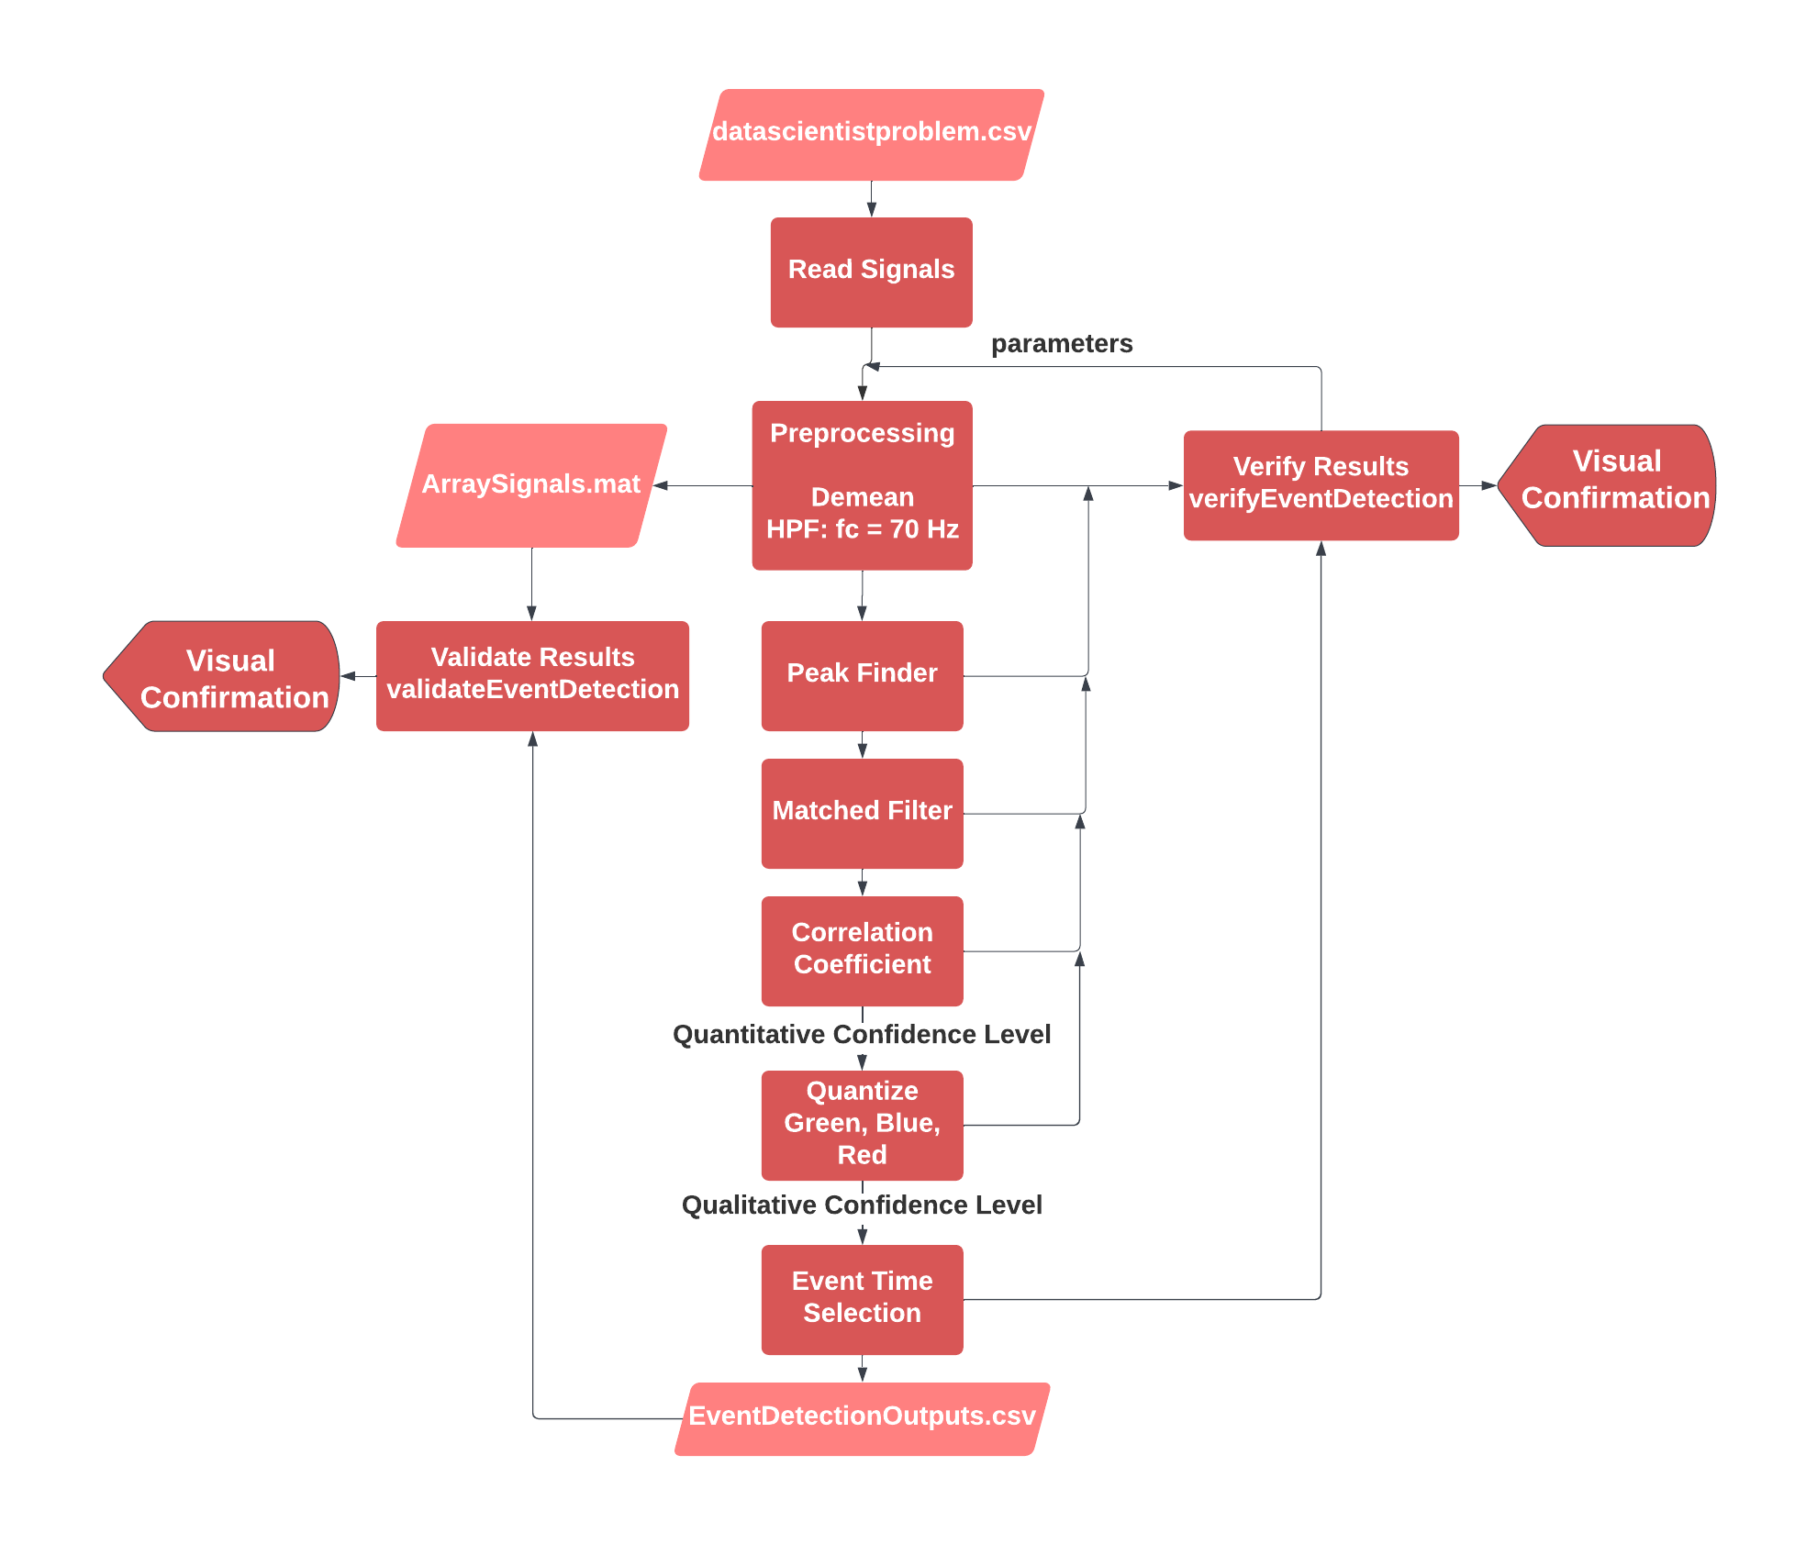
PART I: EVENT DETECTION

Slide 3
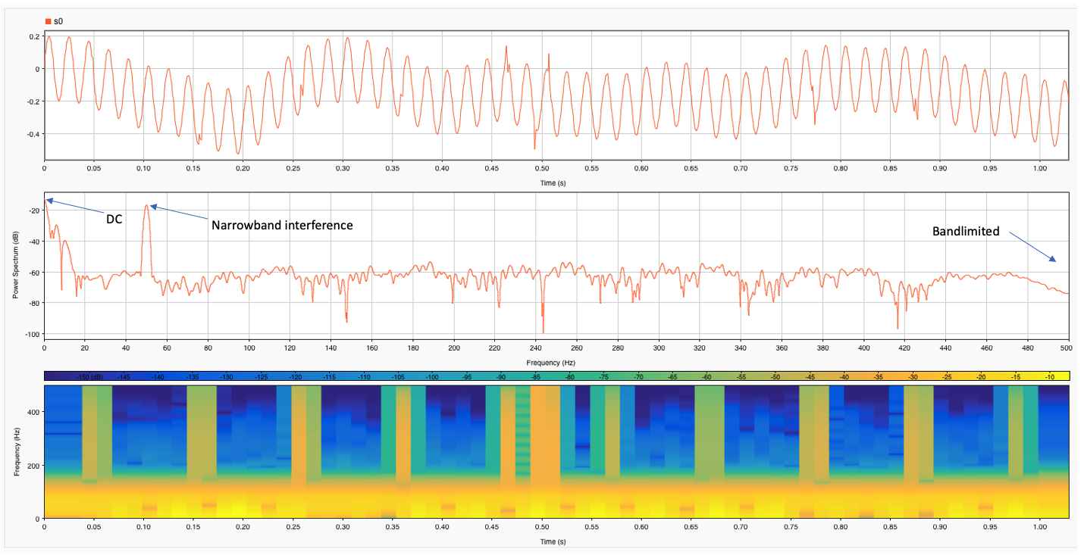
PART II: WAVEFORM DESCRIPTION

Slide 4
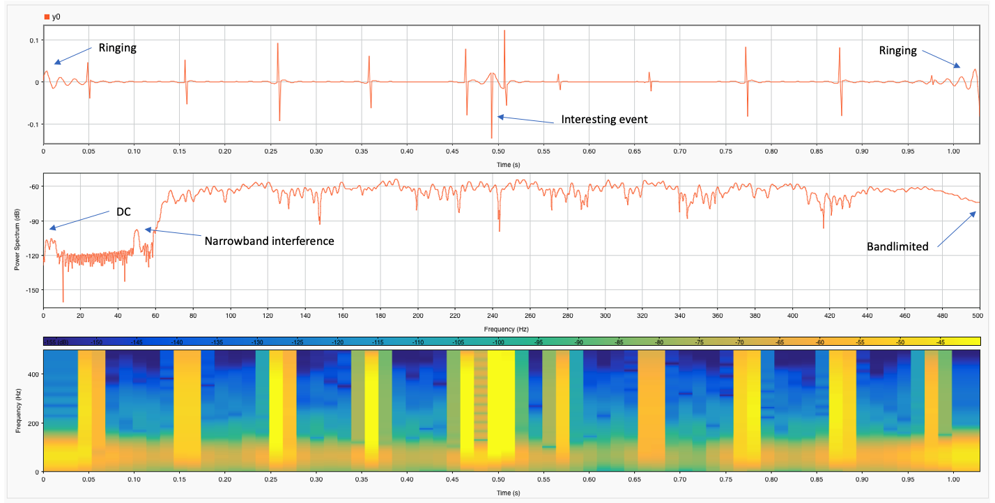
PART II: WAVEFORM DESCRIPTION

Slide 5
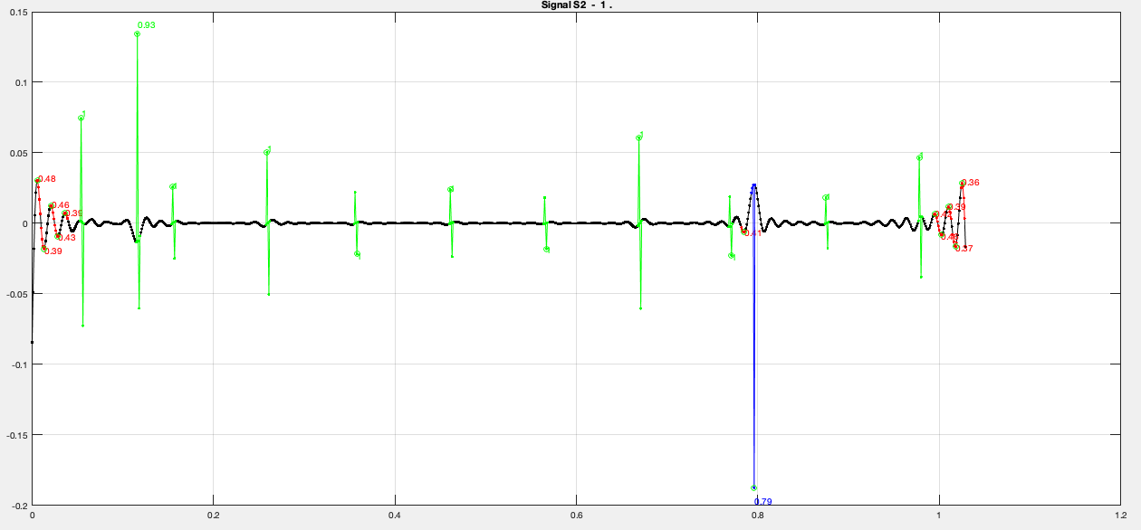
PART II: WAVEFORM DESCRIPTION

Slide 6
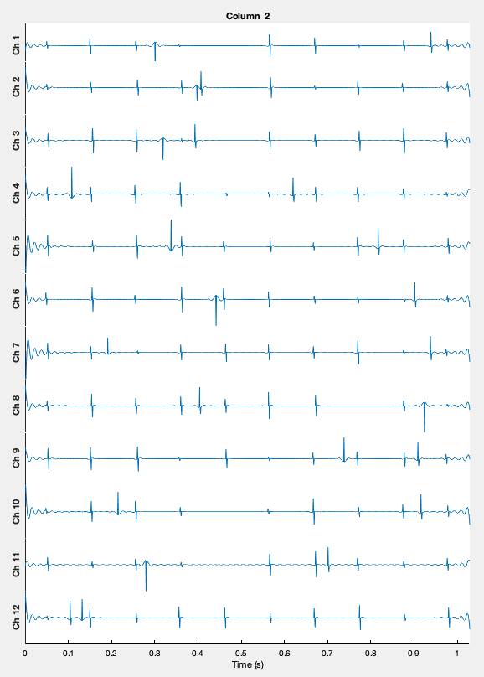
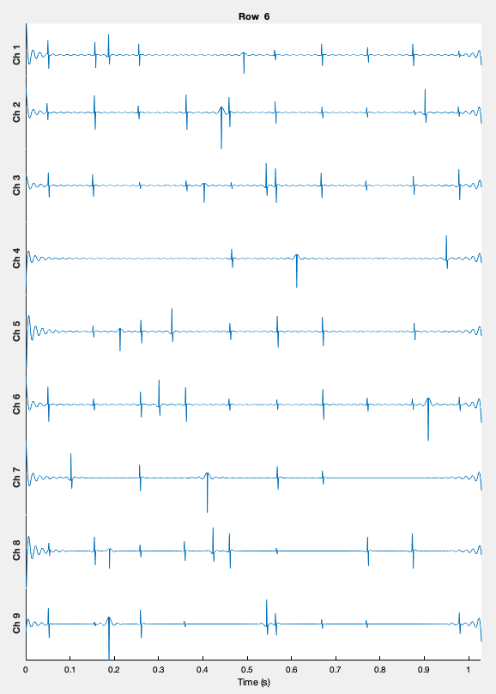
PART III: EVENT PATTERNS

Slide 7
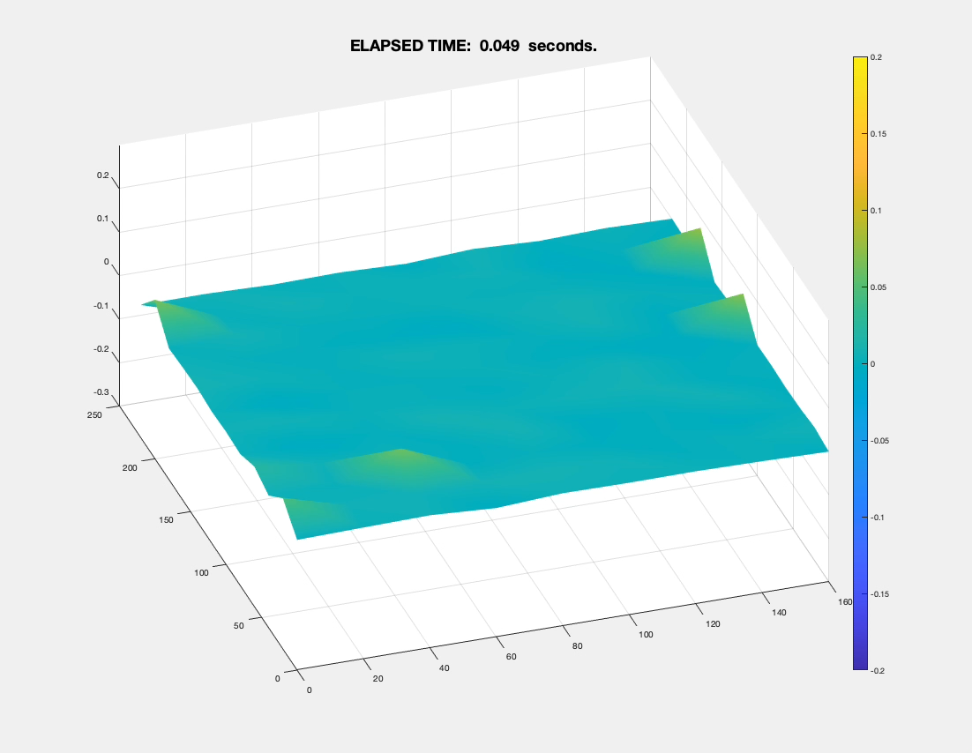
PART III: EVENT PATTERNS

Slide 8
PART IV: MACHINE LEARNING
What features would be useful? For the detection problem, we could imagine features that provide local information about the events, as well as the relationship of the event to other events in the measurements. For example, are the features extracted from an event that is part of a cluster in time or spatially on the array. Local features might include correlation coefficient with a wavelet template, amplitude, symmetry, rise time, deflection direction, and overall duration. Also, we saw the t-f spectrogram of the 'indeterminants' were characteristic and distinct from the 'genuine' events.
For non-local features, we would want to have a measure of whether the events are part of a burst in time or spatially. Intermittent random events that occur between bursts of activity across the array might be considered false positives.
What ML methods would be useful? This is the realm of classification as opposed to regression. Since we are working with a labeled data set, supervised learning would be used. Support Vector Machines (SVM) tend to have trouble with very large data sets and the basic implementation is for binary classification problems and not multiclass problems, and do not provide a probalistic output or confidence level. Similarly, nearest neighbor methods like kNN may have trouble with large data sets. Decision trees tend to have problems generalizing and so validation may be a problem. Other methods are worth looking at. For example Naive Bayes classifiers work well with low dimensionality feature vectors (fewer features), and will provide multiclass probabilities.
Artificial Neural Networks and Deep Learning methods are good especially for multiclass problems and in cases like this where there is a large training set. Also, these can be computationally very fast once trained and will provide a score or confidence level to rank the resulting outputs.
Benefits relative to classical signal processing techniques? I think both should work together. Preprocessing, normalization, PCA, correlations, transforms, and so on are all based on traditional signal processing and provide critical improvements in the performance of classifiers in general.

